Slide 1
PROJECT: CROWDFIX
TEAM MEMBERS
1, B.K DOL BAHADUR(230191)
2, BASNET ANJALI (2301461)
3, SAPKOTA PRATIK (230175
4, BHOTE UMANG(2301515)

Slide 2
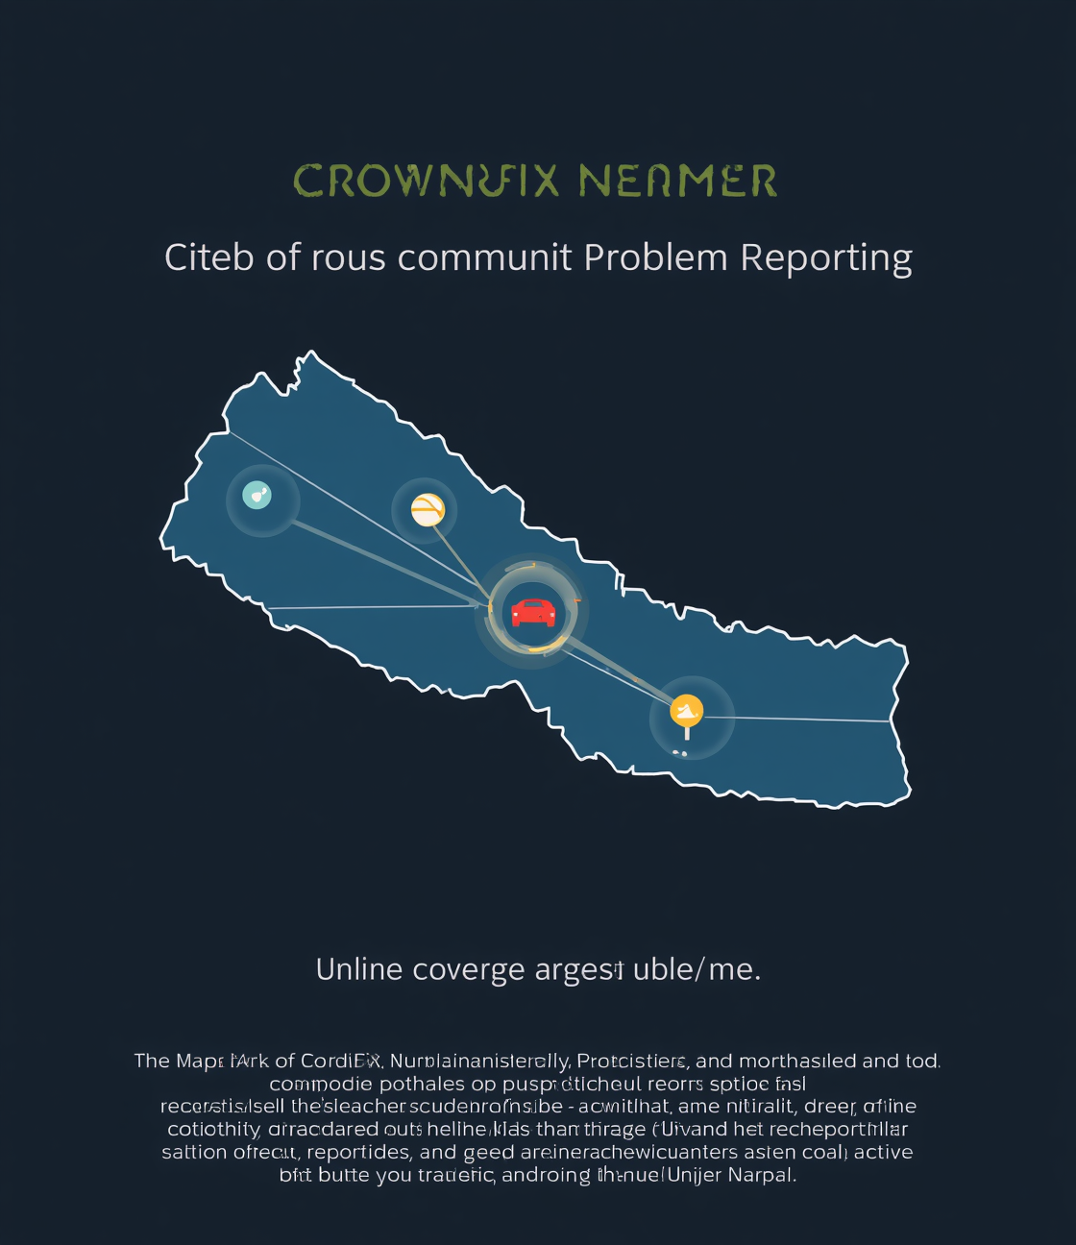
CrowdFix Nepal
Department of Information Security

Slide 3

Community Reporting for Nepal
Empowering Citizens to Report Issues
Citizens can easily identify problems
Streamlined Reporting Process for Authorities
Reports are routed to relevant offices
Enhancing Civic Engagement and Transparency
Upvotes prioritize community concerns

Slide 4
Key Features of CrowdFix Nepal
Geotagging
Community Engagement
Interactive Map
Reports are linked to specific locations.
Users view all reported issues visually.
Citizens can upvote and comment on issues.
Authority Dashboard
Notifications
Municipal authorities can manage and track reports.
Users receive updates on report statuses.

Slide 5
CrowdFix Nepal: Scope Definition
In Scope
Out of Scope
Key features include user registration, geotagged reporting, community interaction, authority dashboards, and notifications.
Future phases exclude integration with legacy systems and AI image classification capabilities.

Slide 6
Understanding User Interactions and Roles
Use Case Dynamics
Visual representation of user interactions

Slide 7
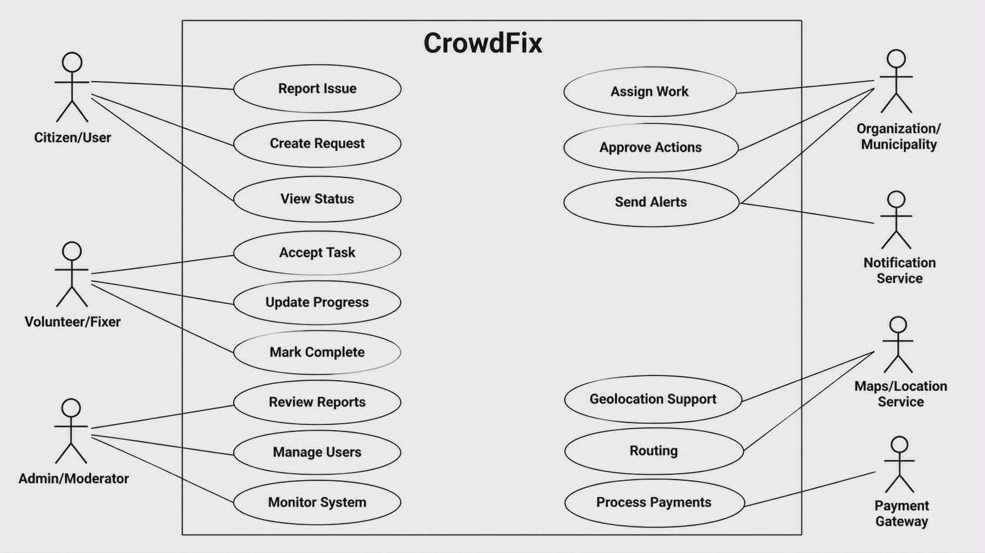

Slide 8
CrowdFix Nepal Context Diagram
Visual Representation of System Interactions
Illustrating entities and data flow connections

Slide 9
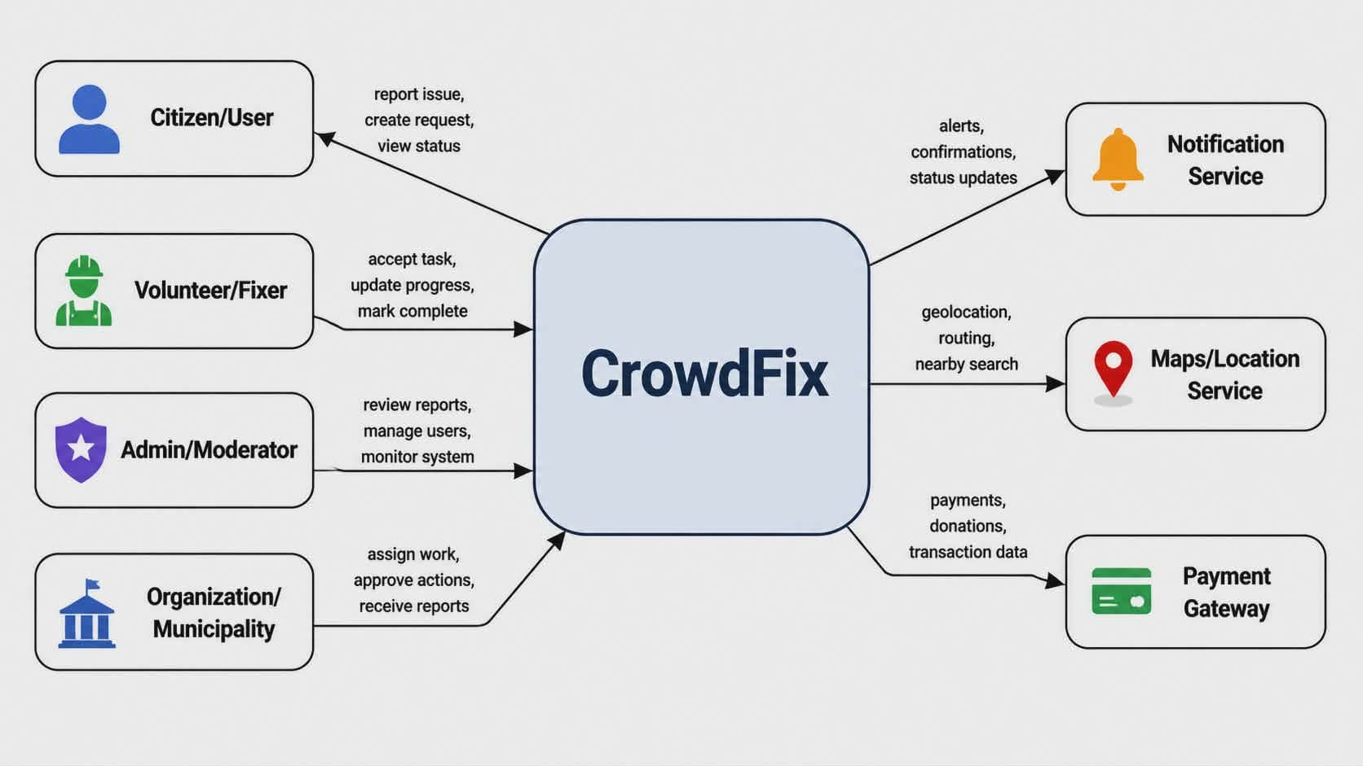

Slide 10
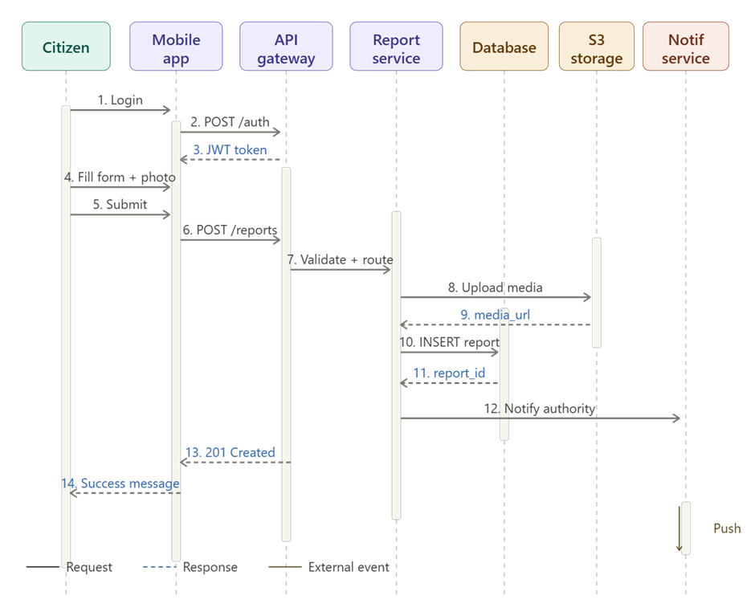
Report Submission Process Overview
Simplified sequence of actions
Visualizing the steps for effective reporting

Slide 11
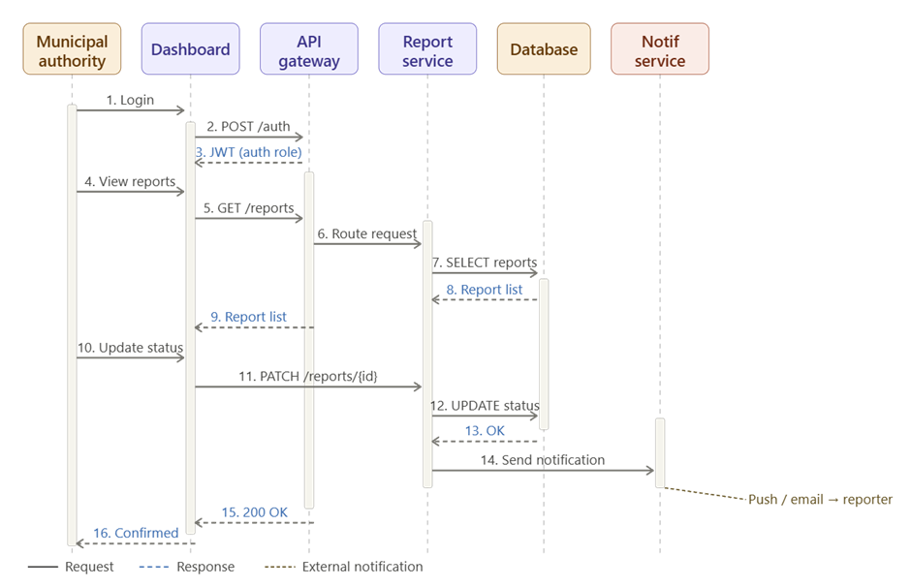
Report Submission Process Overview
Simplified sequence of actions
Visualizing the steps for effective reporting

Slide 12
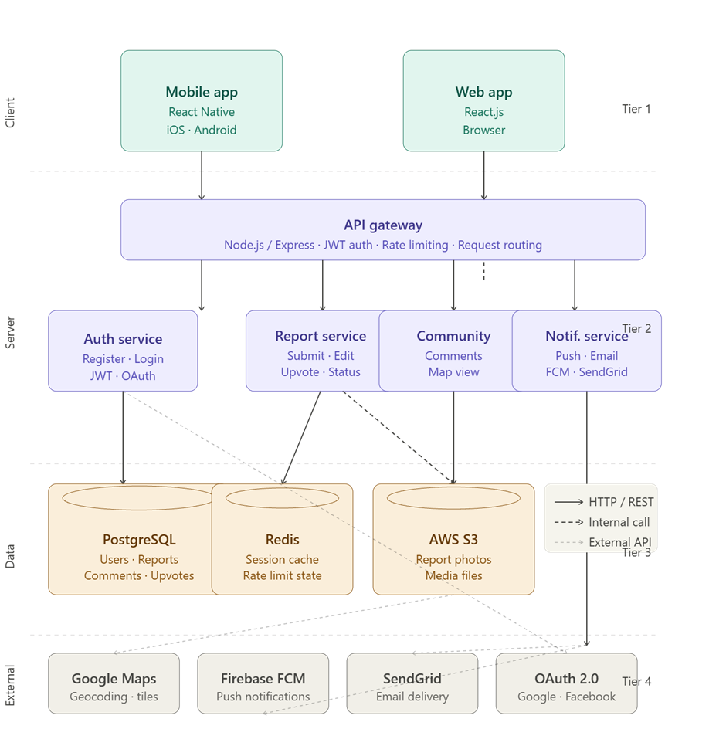
CrowdFix Nepal Client-Server Architecture
Comprehensive system structure overview
Visual representation of the client-server architecture showing all tiers and interactions.

Slide 13
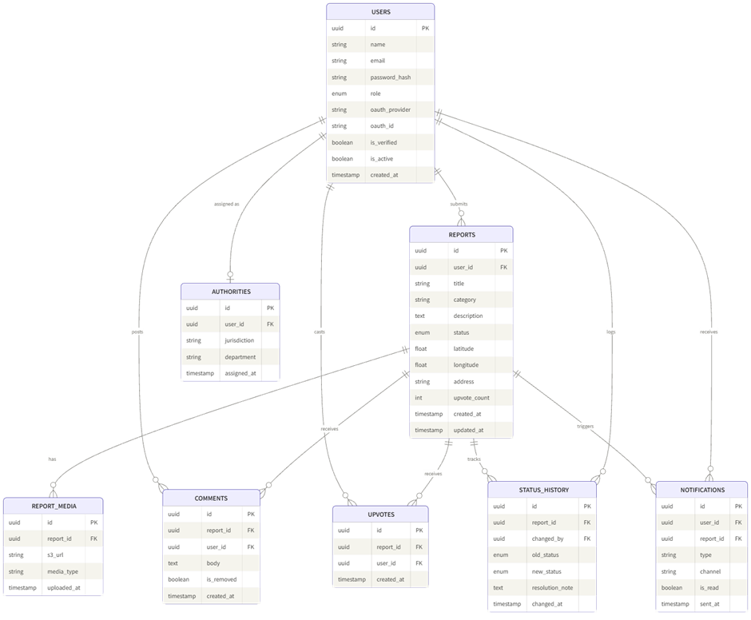
CrowdFix Nepal Database Schema Overview
Visual Representation of Relationships
Detailed structure of user and report interactions

Slide 14
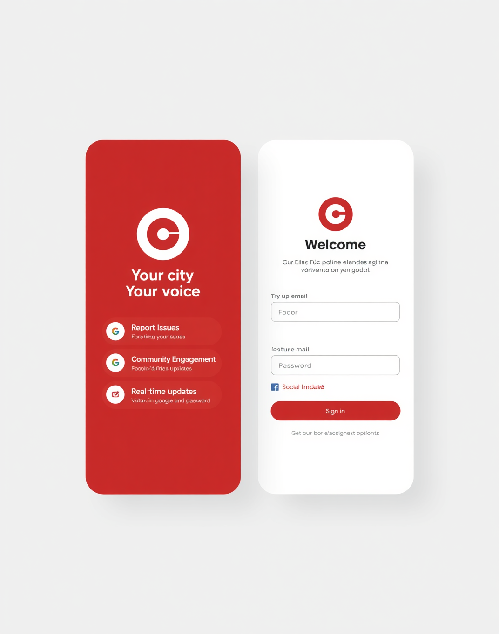
Mockup of CrowdFix Nepal Login Screen
User-Friendly Interface for Problem Reporting
The CrowdFix Nepal login screen features a clean design and intuitive layout, allowing users to quickly access the platform for reporting local issues and engaging with their community.

Slide 15
Requirements Traceability Matrix4
Crowdfix — Community Problem Reporting Application
Team Crowdfix (Sapkota Pretik . Bhotey Umang . BK Dol Bahadur . Basnet Anjali)
SRS v1.0 · Requirements → Test Cases | 31 Requirements | 53 Test Cases
Req. ID | Type | Subsystem | Requirement | Priority | Test Case ID | Test Case Name | Test Description | Expected Result | Test Status | Test Result | Defect ID | Defect Status | Developer
FR-01 | Functional | Authentication | Users can register via email/password or OAuth (Google, Facebook) | High | TC-01 | Register with email | Enter valid email, password; submit registration form | Account created; verification email sent | Not Run
FR-01 | Functional | Authentication | Users can register via email/password or OAuth (Google, Facebook) | High | TC-02 | Register with Google OAuth | Click 'Sign in with Google'; complete OAuth flow | Account created and linked to Google; user logged in | Not Run
FR-02 | Functional | Authentication | Email addresses are validated via a verification link before account activation | High | TC-03 | Email verification | Register; click verification link in email | Account status changes to Active; login allowed | Not Run
FR-02 | Functional | Authentication | Email addresses are validated via a verification link before account activation | High | TC-04 | Login without verifying email | Register; attempt login before verifying email | Login rejected; prompt shown to verify email first | Not Run
FR-03 | Functional | Authentication | Password hashing enforced (bcrypt, min cost factor 10) | High | TC-05 | Password stored securely | Register user; inspect DB record | Password field contains bcrypt hash, not plaintext | Not Run
FR-04 | Functional | Authentication | Password reset via email OTP | High | TC-06 | Password reset flow | Click 'Forgot password'; enter email; use OTP | Password successfully reset; old password no longer works | Not Run
FR-05 | Functional | Authentication | Users can update profile name, photo, contact details | Medium | TC-07 | Edit profile | Change display name and photo; save | Profile updated and reflected immediately in UI | Not Run
FR-06 | Functional | Authentication | Admin can deactivate or ban user accounts | Medium | TC-08 | Admin deactivates user | Admin opens user record; clicks Deactivate | User cannot log in; sees account deactivated message | Not Run
FR-07 | Functional | Report Submission | Submit a report with title, category, description, photo(s), location | High | TC-09 | Submit full report | Fill all fields; attach photo; submit | Report created with unique ID; appears on map | Not Run
FR-07 | Functional | Report Submission | Submit a report with title, category, description, photo(s), location | High | TC-10 | Submit report with missing required field | Leave title blank; submit | Validation error shown; report not created | Not Run
FR-08 | Functional | Report Submission | Auto-detect GPS coordinates; allow manual map adjustment | High | TC-11 | Auto GPS detection | Open new report form with location enabled | Current GPS coordinates pre-filled on map | Not Run
FR-08 | Functional | Report Submission | Auto-detect GPS coordinates; allow manual map adjustment | High | TC-12 | Manual pin adjustment | Drag map pin to different location; submit | Report saved with manually adjusted coordinates | Not Run
FR-09 | Functional | Report Submission | Report categories: Infrastructure, Sanitation, Public Safety, Utilities, Environment, Other | High | TC-13 | Category selection | Open category dropdown; select each option | All 6 categories available and selectable | Not Run
FR-10 | Functional | Report Submission | Up to 5 photos per report, each up to 10 MB | Medium | TC-14 | Photo upload limit | Attach 5 photos each under 10 MB | All 5 photos uploaded successfully | Not Run
FR-10 | Functional | Report Submission | Up to 5 photos per report, each up to 10 MB | Medium | TC-15 | Exceed photo file size | Attach a photo larger than 10 MB | Error shown; oversized photo rejected | Not Run
FR-11 | Functional | Report Submission | Unique report ID and timestamp assigned on submission | High | TC-16 | Report ID assigned | Submit a valid report | Report record has unique ID and correct timestamp | Not Run
FR-12 | Functional | Report Submission | Draft saving for offline submissions | Low | TC-17 | Save draft offline | Disable network; fill form; save draft | Draft saved locally; visible in Drafts list | Not Run
FR-13 | Functional | Report Submission | Reporter can edit report within 30 minutes of submission | Medium | TC-18 | Edit within 30 min | Submit report; edit title within 30 min window | Edit saved successfully | Not Run
FR-13 | Functional | Report Submission | Reporter can edit report within 30 minutes of submission | Medium | TC-19 | Edit after 30 min | Submit report; attempt edit after 30 min window | Edit option disabled or error shown | Not Run
FR-14 | Functional | Community | Registered users can upvote any report (one per user per report) | High | TC-20 | Upvote a report | Logged-in user clicks upvote on a report | Upvote count increments by 1 | Not Run
FR-14 | Functional | Community | Registered users can upvote any report (one per user per report) | High | TC-21 | Duplicate upvote | Upvote same report twice | Second upvote rejected; count unchanged | Not Run
FR-15 | Functional | Community | Users can retract their upvote | Medium | TC-22 | Retract upvote | Upvote a report; click upvote again to retract | Upvote count decrements by 1 | Not Run
FR-16 | Functional | Community | Registered users can post text comments on reports | Medium | TC-23 | Post a comment | Type comment text; submit | Comment appears in report thread with timestamp | Not Run
FR-17 | Functional | Community | Comment authors can delete their own comments | Low | TC-24 | Delete own comment | Click delete on own comment | Comment removed from thread | Not Run
FR-18 | Functional | Community | Admins can moderate and remove inappropriate comments | High | TC-25 | Admin removes comment | Admin clicks remove on any comment | Comment deleted regardless of author | Not Run
FR-19 | Functional | Status Management | Report lifecycle: Open → Assigned → In Progress → Resolved → Closed | High | TC-26 | Status lifecycle | Authority moves report through all statuses | Each status transition recorded with timestamp | Not Run
FR-20 | Functional | Status Management | Authorities update report status from dashboard | High | TC-27 | Authority updates status | Authority selects report; changes status | Status updated; visible to all users | Not Run
FR-21 | Functional | Status Management | Authorities can attach resolution notes and photos when marking Resolved | Medium | TC-28 | Attach resolution note | Mark report Resolved; add note and photo | Note and photo saved and visible on report | Not Run
FR-22 | Functional | Status Management | Reporter notified of every status change via push and/or email | High | TC-29 | Status change notification | Authority changes status | Reporter receives push notification within 30 seconds | Not Run
FR-23 | Functional | Status Management | Reports Resolved for 7+ days auto-close without dispute | Low | TC-30 | Auto-close after 7 days | Set report to Resolved; wait 7 days (or mock time) | Report status changes to Closed automatically | Not Run
FR-24 | Functional | Map View | All Open and In Progress reports shown on interactive map | High | TC-31 | Map displays reports | Open map view | All active reports shown as pins on map | Not Run
FR-25 | Functional | Map View | Map pins color-coded by category | Medium | TC-32 | Color-coded pins | Open map with reports of different categories | Each category displays a distinct pin color | Not Run
FR-26 | Functional | Map View | Filter map by category, status, and date range | Medium | TC-33 | Filter by category | Select 'Sanitation' filter on map | Only Sanitation reports shown | Not Run
FR-27 | Functional | Map View | Clicking a pin shows summary and link to full report | High | TC-34 | Pin click popup | Click a map pin | Popup shows title, status, upvotes, and link to full report | Not Run
FR-28 | Functional | Authority Dashboard | Authority dashboard lists all reports in their jurisdiction | High | TC-35 | Dashboard report list | Authority logs in; opens dashboard | Only reports within authority's jurisdiction are shown | Not Run
FR-29 | Functional | Authority Dashboard | Dashboard sorts by date, upvotes, category, status | High | TC-36 | Sort by upvotes | Click 'Upvotes' column header | Reports sorted descending by upvote count | Not Run
FR-30 | Functional | Authority Dashboard | Authorities can assign reports to specific field officers | Medium | TC-37 | Assign to officer | Select report; assign to a field officer | Report shows assigned officer name | Not Run
FR-31 | Functional | Authority Dashboard | Export reports as CSV or PDF | Low | TC-38 | Export as CSV | Click Export → CSV | CSV file downloaded with all visible report data | Not Run
NFR-01 | Non-Functional | Performance | Support at least 1,000 concurrent users without degradation | High | TC-39 | Load test 1000 users | Run load test with 1,000 concurrent virtual users | No errors; response times within limits | Not Run
NFR-02 | Non-Functional | Performance | API responses within 2 seconds at 95th percentile under normal load | High | TC-40 | API response time | Run 500 API requests; measure 95th percentile latency | P95 latency ≤ 2000 ms | Not Run
NFR-03 | Non-Functional | Performance | Map tile rendering within 3 seconds on 4G | High | TC-41 | Map load time | Load map on 4G-throttled connection; time tile render | Map tiles fully rendered within 3 seconds | Not Run
NFR-04 | Non-Functional | Security | All data in transit encrypted with TLS 1.2+ | High | TC-42 | TLS enforcement | Attempt HTTP connection to API | Connection refused or redirected to HTTPS | Not Run
NFR-05 | Non-Functional | Security | Passwords hashed with bcrypt, min cost factor 10 | High | TC-43 | Bcrypt cost factor | Inspect stored password hash | Hash prefix confirms bcrypt with cost ≥ 10 | Not Run
NFR-06 | Non-Functional | Security | JWT-based authentication with 1-hour expiry | High | TC-44 | JWT expiry | Use a token after 1 hour has passed | Request rejected with 401 Unauthorized | Not Run
NFR-07 | Non-Functional | Security | Rate limiting: max 100 API requests per minute per user | High | TC-45 | Rate limit enforcement | Send 101 requests in 1 minute from same user | 101st request returns 429 Too Many Requests | Not Run
NFR-08 | Non-Functional | Security | User location not exposed at street-level precision on public map | High | TC-46 | Location precision on map | View public map as guest | Pin locations are approximate, not exact street address | Not Run
NFR-09 | Non-Functional | Reliability | 99.5% uptime measured monthly | High | TC-47 | Uptime monitoring | Review monthly uptime logs from monitoring tool | Uptime ≥ 99.5% | Not Run
NFR-10 | Non-Functional | Reliability | Automated database backups every 24 hours | High | TC-48 | DB backup verification | Check backup logs after 24 hours | Backup file created; restoration test succeeds | Not Run
NFR-12 | Non-Functional | Usability | New users submit first report within 5 minutes without training | High | TC-49 | First-time usability | Give new user an account; time to first report | Report submitted in under 5 minutes | Not Run
NFR-13 | Non-Functional | Usability | UI complies with WCAG 2.1 Level AA | High | TC-50 | Accessibility audit | Run automated accessibility scanner on all screens | Zero Level AA violations reported | Not Run
NFR-15 | Non-Functional | Maintainability | Test coverage ≥ 70% | High | TC-51 | Code coverage report | Run test suite with coverage reporting | Coverage report shows ≥ 70% | Not Run
NFR-16 | Non-Functional | Maintainability | CI/CD pipeline via GitHub Actions | High | TC-52 | CI/CD pipeline | Push code to main branch | GitHub Actions runs tests and deploys automatically | Not Run
NFR-17 | Non-Functional | Maintainability | All API endpoints documented with Swagger/OpenAPI 3.0 | Medium | TC-53 | Swagger docs | Open /api-docs endpoint | All FR-01–FR-31 endpoints documented with schemas | Not Run
★ Tracking columns (navy) — fill during testing: Test Status: Not Run / In Progress / Passed / Failed / Blocked Test Result: Pass / Fail / N/A Defect ID: GitHub issue # or JIRA ticket Defect Status: None / Open / In Progress / Fixed / Closed Developer: responsible team member

Slide 16
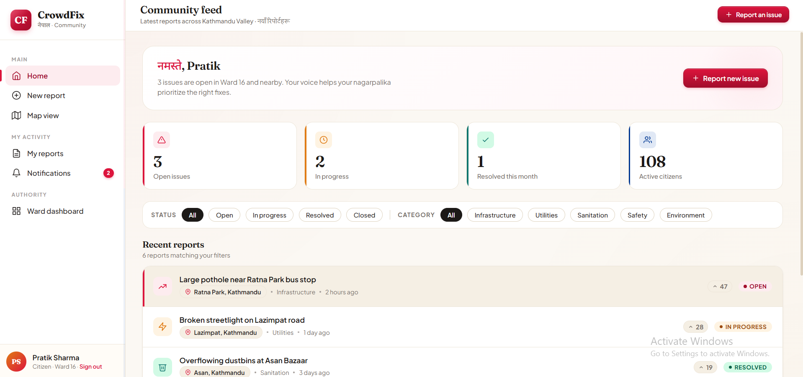
Thank You

